Slide 1
Atomic structure-2
23/07/2023
Dr. Muhammed Shah Miran
Professor, Department of Chemistry
University of Dhaka, Dhaka 1000

Slide 2
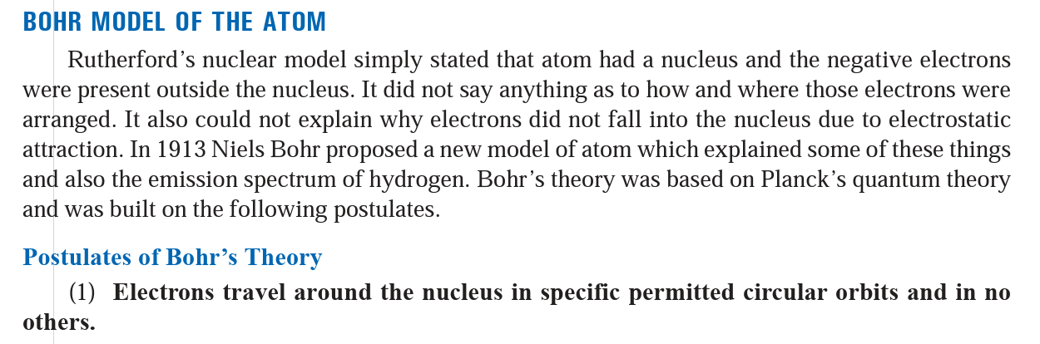
State the postulates of Bohr’s theory of the hydrogen atom. Derive an expression for the nth orbit of a hydrogen atom. Derive an expression for the radius of any orbit in the atom.
Using Bohr’s atomic model, derive an equation for total energy of orbit of an electron

Slide 3
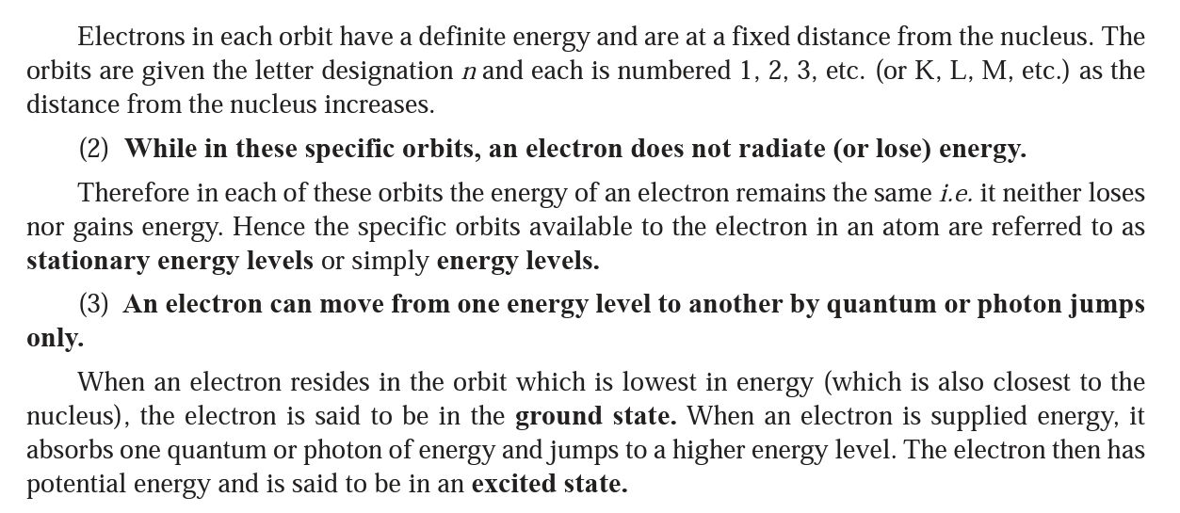

Slide 4
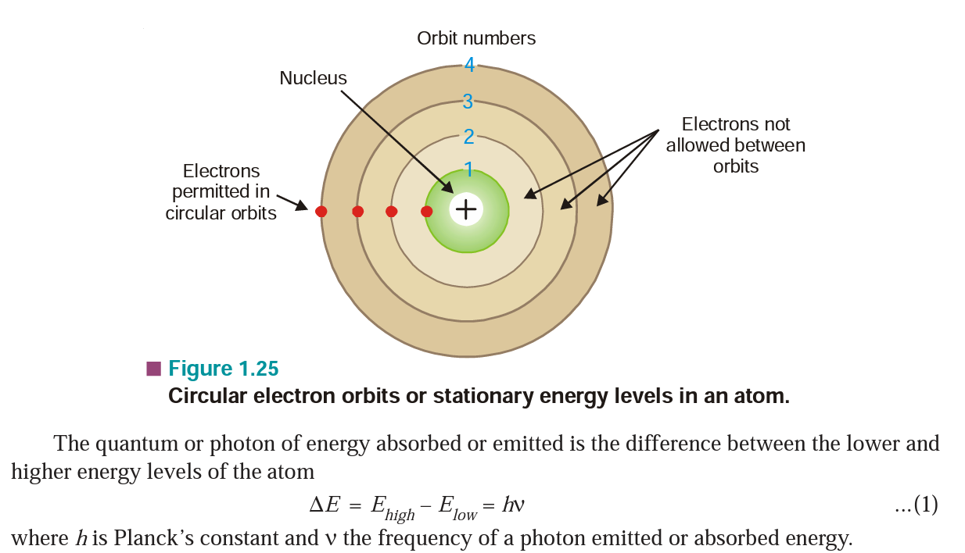

Slide 5
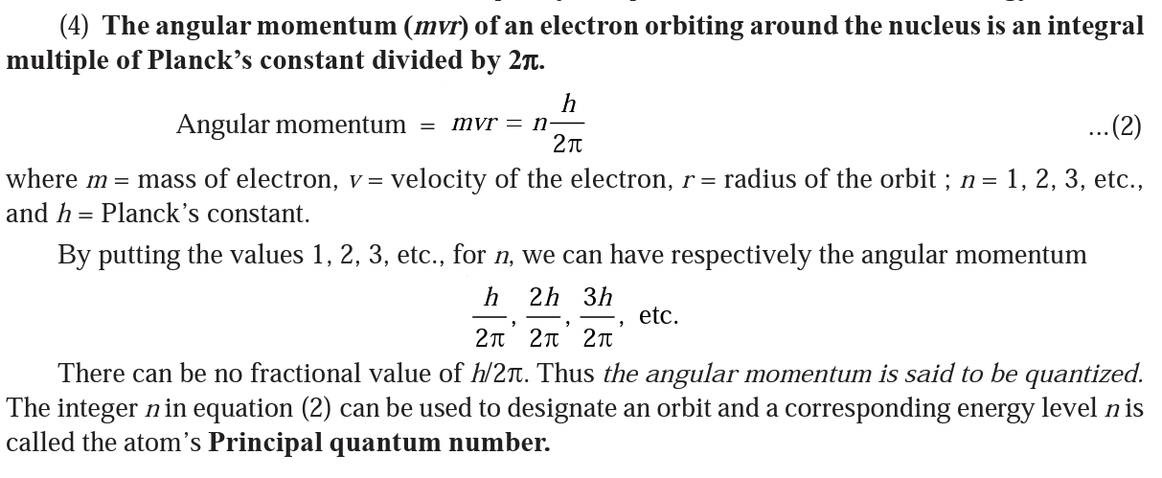

Slide 6
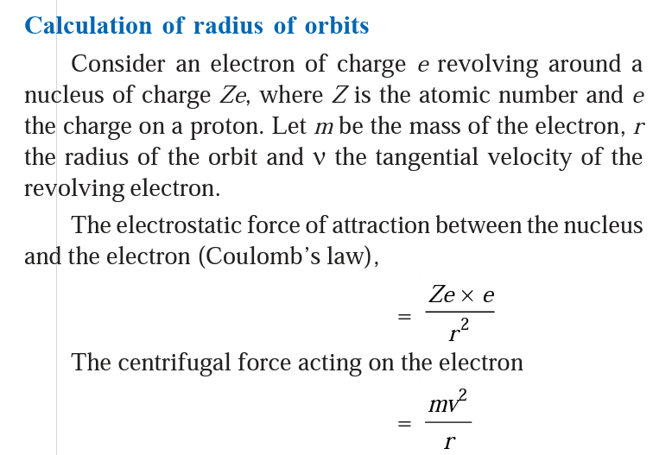
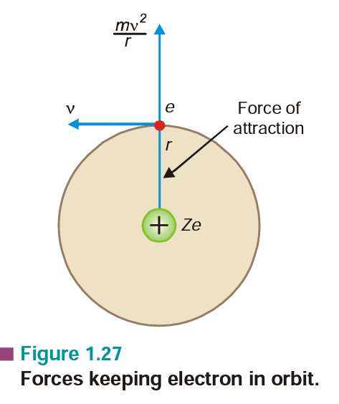

Slide 7
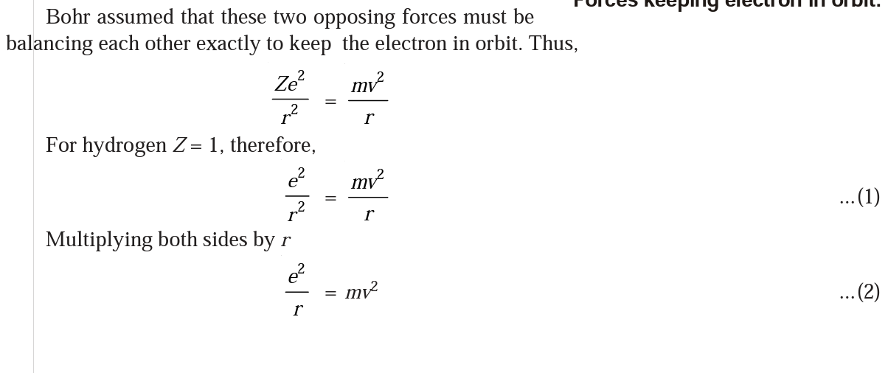

Slide 8
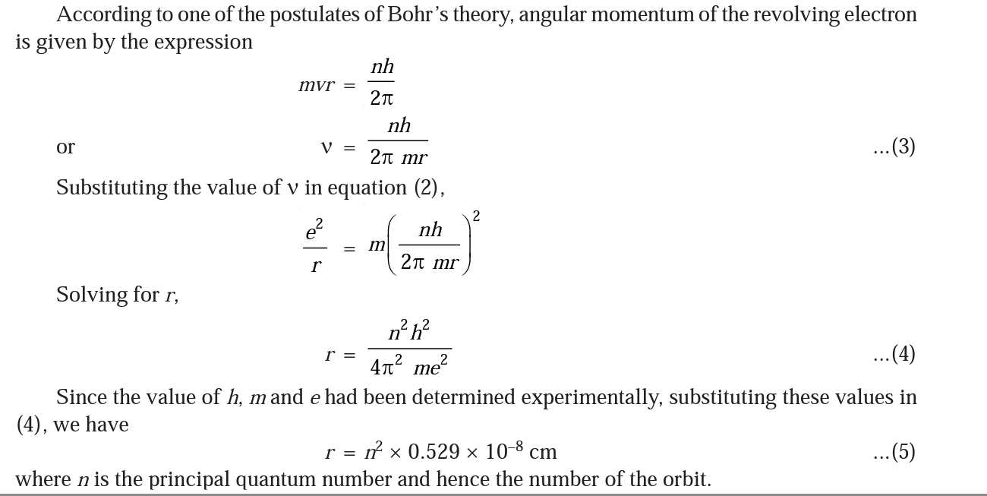

Slide 9
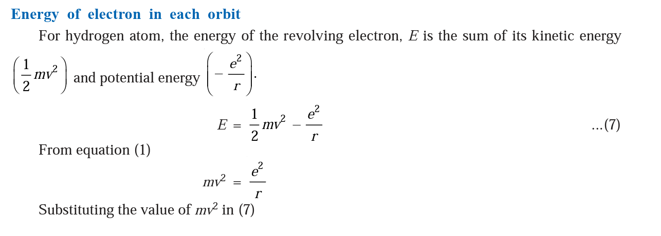

Slide 10
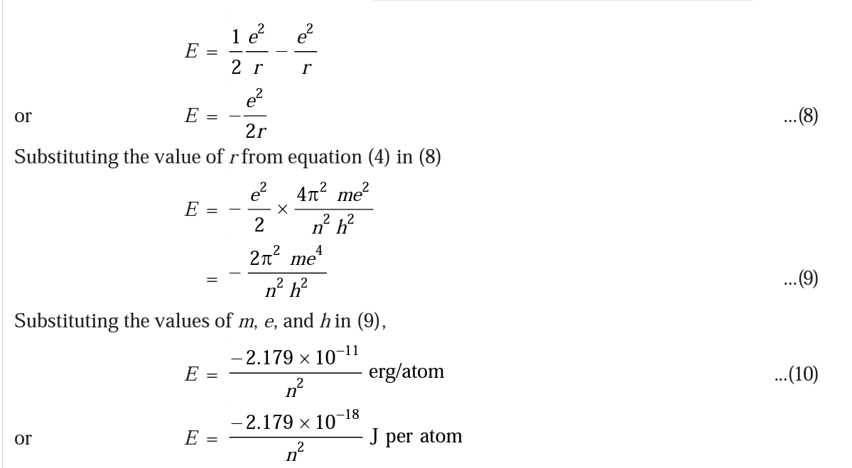

Slide 11
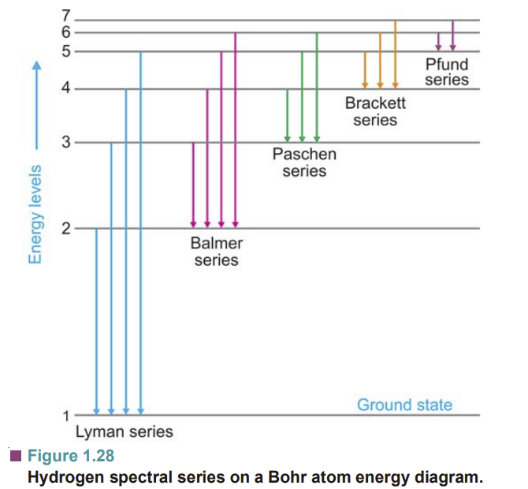
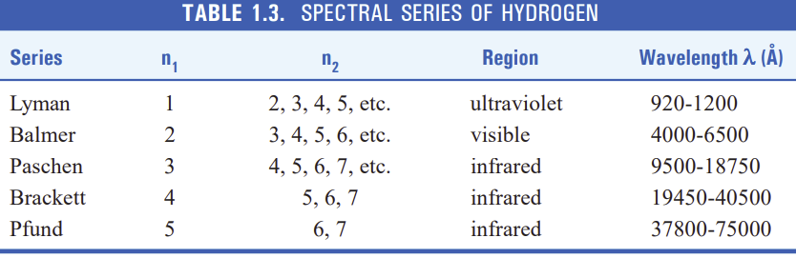
Bohr’s Explanation of Hydrogen Spectrum

Slide 12
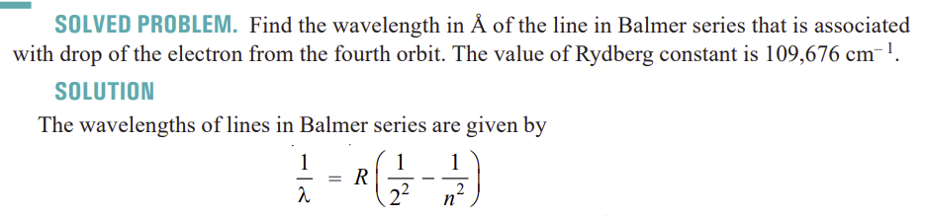
What is the wavelength of a photon emitted during a transition from the n_{i} = 5 state to the n_{f} = 2 state in the hydrogen atom? R_{h} = 109679 cm⁻¹.

Slide 13
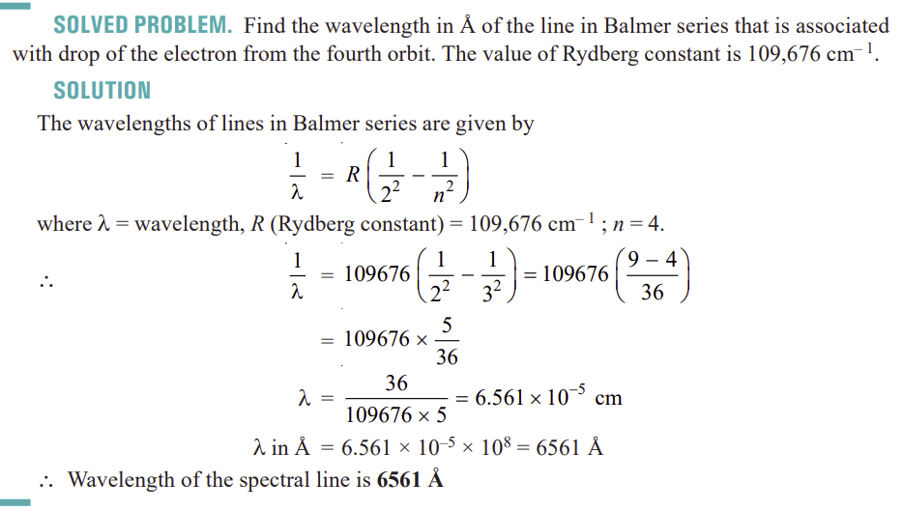

Slide 14
